Slide 1
Farm_era: Advanced GIS field mapping, precision crop planning, input tracking, AI-powered pest management, real-time weather updates, smart irrigation, and powerful data analytics for optimized farming.
PIP104 PROFESSIONAL PRACTICE-II
VIVA-VOCE
Batch Number: ISE-G04
Roll Number | Student Name
20201ISE0032 | Vishnu Reddy Kotam
20201ISE0038 | Bellakki Vinayak
20201ISB0025 | Suhas N
20201ISE0043 | Rohini N
Under the Supervision of,
Dr. R Vignesh
Associate Professor
School of Computer Science & Engineering
Presidency University

Slide 2
Introduction
This presents "Farm_era," a cutting-edge agricultural platform that fuses Advanced GIS mapping with precision crop planning, ensuring meticulous input management. It harnesses AI for targeted pest control and utilizes instantaneous weather forecasts to inform smart irrigation systems. The framework integrates environmental conditions with historical crop data, enabling refined yield estimates. This convergence of technology aims to revolutionize farming by optimizing resource usage, improving pest management, and delivering actionable insights through robust data analytics, ultimately leading to sustainable farming practices and maximized agricultural output.

Slide 3
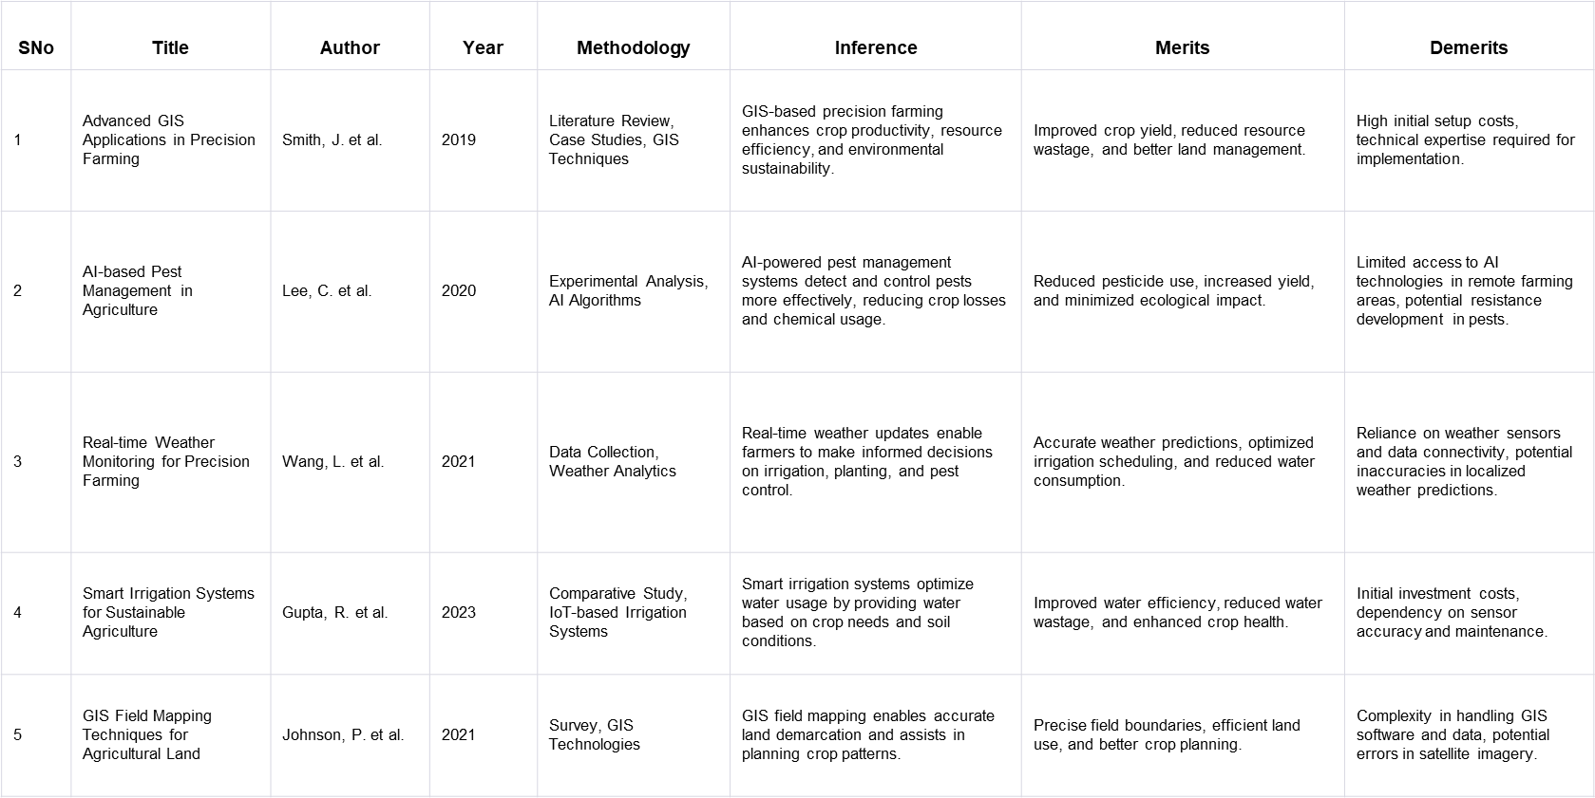
Literature Review

Slide 4
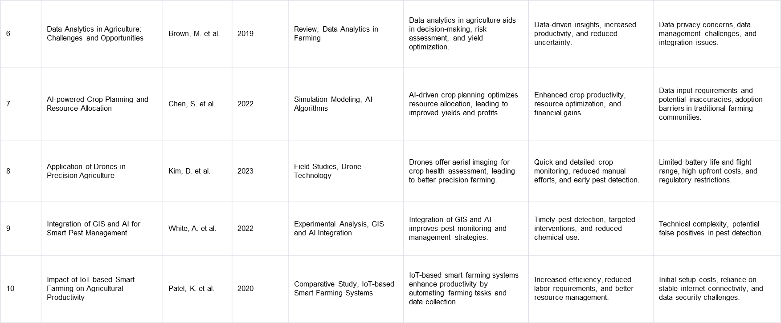
Literature Review

Slide 5
Research Gaps Identified
Farm_era, a comprehensive agricultural technology platform, holds great promise for modern farming practices, but it also reveals several critical research gaps and areas for improvement that warrant in-depth exploration and innovation. One of the foremost challenges lies in achieving seamless integration among the diverse components of the system. While Farm_era offers an array of advanced features, ensuring these modules work together harmoniously can be a complex task. Researchers could delve into developing standardized protocols or application programming interfaces (APIs) that facilitate smoother integration and data exchange, ensuring that the wealth of data generated within the platform can be effectively utilized. Data privacy and security also emerge as significant concerns in the context of Farm_era. With its reliance on data analytics and cloud-based services, safeguarding sensitive farm data becomes paramount. Research initiatives could concentrate on fortifying the security of farm data through robust encryption, multi-factor authentication, and stringent access control mechanisms, safeguarding against cyber threats and unauthorized access that could compromise the integrity and confidentiality of this critical information. Usability and accessibility are two additional facets demanding attention in Farm_era's development. To ensure that the platform is truly user-friendly and inclusive farmers of varying technological proficiency, researchers may focus on refining the user interface to make more intuitive and accommodating, particularly for older or less tech-savvy farmers. Moreover, multilingual support could be integrated to cater to users from diverse linguistic backgrounds, enabling a broader range of individuals to harness the platform's benefits. As the platform scales and expands its user base, scalability and resource optimization assume increasing importance.

Slide 6
Research Gaps Identified
Researchers could explore methodologies for optimizing resource utilization, thereby allowing Farm_era to accommodate a larger number of users and farms without incurring high infrastructure costs. Technologies such as containerization or serverless computing may offer solutions to this challenge, ensuring that the platform remains cost-effective and accessible to a broader agricultural community. The accuracy of data within Farm_era is paramount, particularly in GIS field mapping and weather forecasting. Herein lies a potential research gap, as ensuring precise and dependable data sources is imperative. Researchers may investigate methods for enhancing the accuracy of data obtained from remote sensing technologies and weather sensors. Machine learning algorithms could be leveraged to rectify inconsistencies in data and fine-tune predictive models, ultimately ensuring that farmers can make informed decisions with the utmost confidence in the reliability of the information at their disposal. AI-powered pest management, a notable feature of Farm_era, offers opportunities for further refinement. Pest detection algorithms could be the subject of intensive research efforts to reduce instances of false positives and negatives, thus enhancing the effectiveness of pest management strategies. Moreover, integrating biological pest control methods into the system could be explored, aligning with sustainable farming practices and potentially reducing the reliance on chemical solutions. In the realm of real-time weather updates, localized data can be challenging to obtain accurately, particularly in regions with limited weather station coverage. Research endeavors may focus on developing or enhancing localized weather prediction models, ensuring that farmers in even the most remote or underserved areas have access to timely and precise meteorological information, enabling them to make proactive decisions in response to changing weather conditions. Smart irrigation, a vital aspect of resource conservation, presents opportunities for efficiency enhancement. Researchers might delve into optimizing irrigation schedules by factoring in soil moisture data, plant types,real-time weather conditions more comprehensively.

Slide 7
Research Gaps Identified
Such an approach could lead to more precise resource utilization and significantly increased water savings, particularly in areas prone to water scarcity. While Farm_era addresses AI-powered pest management, there is also a need to monitor and manage crop diseases effectively. Research avenues could explore the integration of disease detection technologies, such as image recognition and sensor-based disease monitoring, into the platform. This comprehensive approach to crop health management could prove invaluable in ensuring that crops thrive and that potential diseases are identified and addressed promptly. Farm_era's sustainability also warrants examination. Precision agriculture can optimize resource use, but its broader environmental impact needs consideration. Researchers could investigate the platform's overall sustainability, accounting for factors like soil health, biodiversity preservation, and the reduction of chemical inputs. This holistic evaluation can provide valuable insights into the ecological footprint of modern farming practices facilitated by Farm_era. Efforts to enhance energy efficiency in Farm_era's operations can contribute to environmental sustainability. Research initiatives explore renewable energy sources, energy-efficient hardware components, and advanced data center cooling technologies to reduce platform's carbon footprint. This aligns with broader efforts to minimize the environmental impact of data-intensive agricultural technologies. The cost of hardware components, including IoT sensors and cameras, could be a barrier to adoption for some farmers. To address this, researchers might investigate cost-effective alternatives or leasing models that make these technologies more accessible and affordable to a wider range of farming operations. Lowering the cost of entry can democratize access to Farm_era's benefits and encourage more farmers to embrace these advanced tools.

Slide 8
Proposed Methodology
Farm_era offers a comprehensive solution for advanced GIS field mapping, precision crop planning, input tracking, AI-powered pest management, real-time weather updates, smart irrigation, and powerful data analytics to optimize farming. With advanced GIS field mapping, farmers can accurately map their fields, identify boundaries, and efficiently plan their planting and harvesting activities. Precision crop planning ensures that farmers maximize their yield potential by deploying the most suitable crops. Moreover, Farm_era provides input tracking capabilities, enabling farmers to closely monitor and manage their use of fertilizers, pesticides and other key inputs. This helps to reduce waste, ensure sustainability, and improve cost efficiency. AI-powered pest management takes precision farming to the next level by using machine learning algorithms to detect and identify pest infestations early on. This proactive approach allows farmers to take swift and targeted action, minimizing the impact of pests on their crops. Real-time weather updates play a crucial role in making informed decisions on crop management. Farm_era integrates with meteorological data sources to provide farmers with up-to-date information on temperature, humidity, rainfall and other key weather parameters. This information enables farmers to adjust irrigation schedules, optimize pesticide applications, and take appropriate measures to protect their crops from extreme weather events. In addition, Farm_era incorporates smart irrigation technology, which uses sensors and data analytics to determine precise irrigation needs based on soil moisture levels, crop water requirements, and weather conditions. This ensures efficient water usage, minimizes water waste, and promotes sustainable farming practices. Farm_era’s powerful data analytics capabilities bring all the collected data together to generate actionable insights and recommendations. By analysing data on crop performance, input usage, weather patterns, and other relevant factors, farmers can make data-driven decisions to optimize their farming operations, increase productivity, and enhance profitability. The integration of artificial intelligence further enhances the system's ability to continuously learn and improve recommendations over time. Overall, Farm_era offers a complete and integrated solution for farmers to embrace precision farming and harness the power of advanced technology for optimized farming practices.

Slide 9
Objectives
The primary objective of Farm_era is to revolutionize modern agriculture by harnessing cutting-edge technology to optimize farming practices. Our mission is to empower farmers with advanced tools and solutions to address the following
key objectives:
Precision Farming: Farm_era aims to enable precise and data-driven farming practices through GIS field mapping and precision crop planning. This ensures optimal land usage and resource allocation.
2. Pest Management: By utilizing AI-powered pest management systems, Farm_era seeks to minimize crop losses caused by pests while reducing the reliance on chemical pesticides, promoting sustainable agriculture.
3. Resource Efficiency: We strive to enhance resource efficiency by providing real-time weather updates and smart irrigation solutions, enabling farmers to conserve water and energy resources while improving crop yields.
4. Data-Driven Insights: Farm_era's powerful data analytics tools are designed to offer farmers actionable insights into their operations, helping them make informed decisions and increase overall farm productivity.
5. Sustainability: Our overarching goal is to promote environmentally sustainable farming practices, reducing the ecological footprint of agriculture and contributing to food security on a global scale.
Farm_era is committed to revolutionizing agriculture for a more sustainable, efficient, and productive future.

Slide 10
System Design & Implementation
Farm_era offers a comprehensive solution for advanced GIS field mapping, precision crop planning, input tracking, AI-powered pest management, real-time weather updates, smart irrigation, and powerful data analytics to optimize farming. With advanced GIS field mapping, farmers can accurately map their fields, identify boundaries, and efficiently plan their planting and harvesting activities. Precision crop planning ensures that farmers maximize their yield potential by deploying the most suitable crops and varieties for their fields based on soil conditions, weather patterns and market demand.
Moreover, Farm_era provides input tracking capabilities, enabling farmers to closely monitor and manage their use of fertilizers, pesticides and other key inputs. This helps to reduce waste, ensure sustainability, and improve cost efficiency. AI-powered pest management takes precision farming to the next level by using machine learning algorithms to detect and identify pest infestations early on. This proactive approach allows farmers to take swift and targeted action, minimizing the impact of pests on their crops.
Real-time weather updates play a crucial role in making informed decisions on crop management. Farm_era integrates with meteorological data sources to provide farmers with up-to-date information on temperature, humidity, rainfall and other key weather parameters. This information enables farmers to adjust irrigation schedules, optimize pesticide applications, and take appropriate measures to protect their crops from extreme weather events.
In addition, Farm_era incorporates smart irrigation technology, which uses sensors and data analytics to determine precise irrigation needs based on soil moisture levels, crop water requirements, and weather conditions. This ensures efficient water usage, minimizes water waste, and promotes sustainable farming practices.

Slide 11
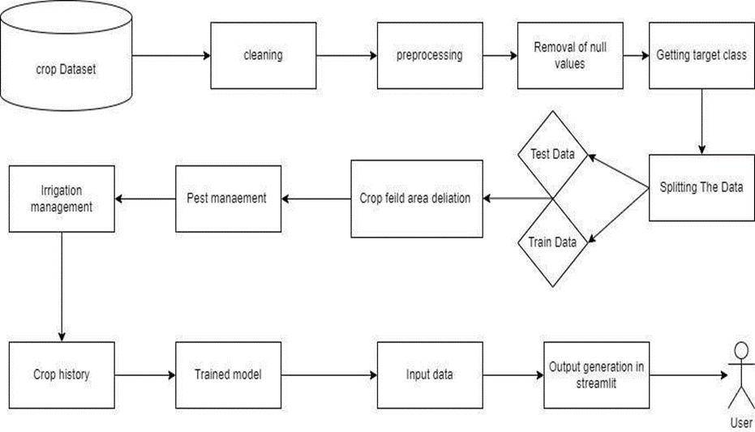
System Design & Implementation
Farm_era’s powerful data analytics capabilities bring all the collected data together to generate actionable insights and recommendations. By analyzing data on crop performance, input usage, weather patterns, and other relevant factors, farmers can make data-driven decisions to optimize their farming operations, increase productivity, and enhance profitability. The integration of artificial intelligence further enhances the system's ability to continuously learn and improve recommendations over time. Overall, Farm_era offers a complete and integrated solution for farmers to embrace precision farming and harness the power of advanced technology for optimized farming practices.
SYSTEM FLOW DIAGRAM:

Slide 12
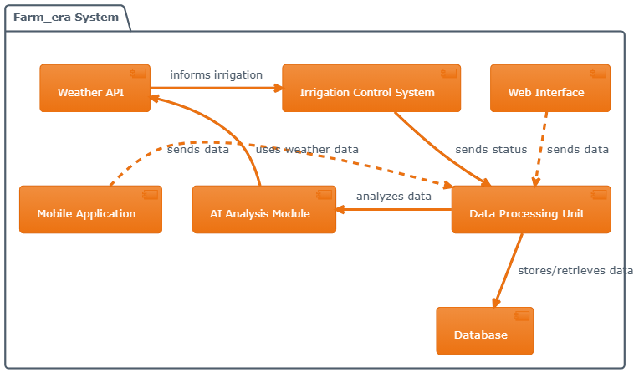
System Design & Implementation
ARCHITECTURE DIAGRAM

Slide 13
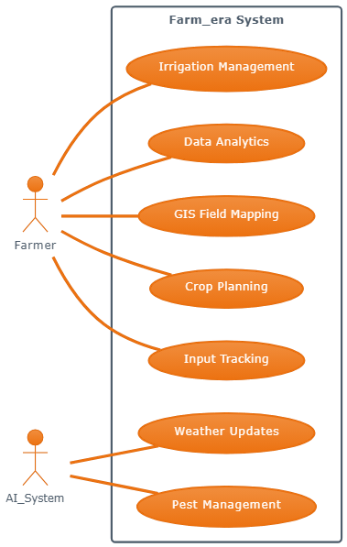
System Design & Implementation
USE CASE DIAGRAM
A use case diagram is used to represent the dynamic behavior of a system. It encapsulates the system's functionality by incorporating use cases, actors, and their relationships. It models the tasks, services, and functions required by a system/subsystem of an application. It depicts the high-level functionality of a system and also tells how user handles a system.The main purpose of a use case diagram is to portray the dynamic aspect of a system. It accumulates the system's requirement, which includes both internal as well as external influences. It invokes persons, use cases, and several things that invoke the actors and elements accountable for the implementation of use case diagrams. It represents how an entity from the external environment can interact with a part of the system.

Slide 14
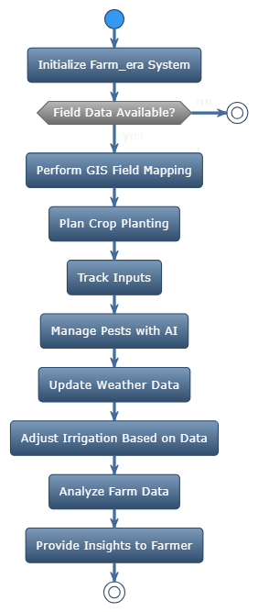
System Design & Implementation
ACTIVITY DIAGRAM
An activity diagram is a kind of graphical representation that may be used to depict events visually. It is made up of a group of nodes that are linked to one another by means of edges. They are able to be connected to any other modelling element, which enables the behaviour of activities to be replicated using that methodology. Simulations of use cases, classes, and interfaces, as well as component collaborations and component interactions, are all made feasible with the help of this tool.

Slide 15
Timeline of Project
S. No. | Review(Offline) | Dates
1 | Review-0 | 09-Oct-2023 to 13-Oct-2023
2 | Review-1 | 06-Nov-2023 to 10-Nov-2023
3 | Review-2 | 27-Nov-2023 to 30-Nov-2023
4 | Review-3 | 26-Dec-2023 to 30-Dec-2023
5 | Final Viva-Voce | 08-Jan-2023 to 12-Jan-2023

Slide 16
Outcomes / Results Obtained
Farm_era, an integrated agricultural technology platform, revolutionizes farming practices with its advanced features. Precision crop planning ensures optimal land use, maximizing crop yields while minimizing resource wastage. Through advanced GIS field mapping, farmers can create accurate field layouts, enabling efficient cultivation.
Input tracking allows farmers to monitor the usage of seeds, fertilizers, and pesticides, reducing costs and environmental impact. AI-powered pest management identifies and addresses pest issues promptly, minimizing crop damage.
Real-time weather updates help farmers make informed decisions, such as adjusting planting schedules or irrigation, to mitigate weather-related risks. Smart irrigation systems conserve water by providing just the right amount of moisture to crops, improving resource efficiency.

Slide 17
Outcomes / Results Obtained
Farm_era's powerful data analytics tools process farm data, providing insights for optimized farming strategies. By analyzing historical data and real-time information, farmers can make data-driven decisions, leading to increased
productivity and profitability.
In summary, Farm_era empowers farmers with technology-driven solutions that enhance crop planning, resource management, and decision-making. It promotes sustainable farming practices, reduces operational costs, and ultimately improves farm outcomes, contributing to food security and environmental conservation.

Slide 18
Conclusion
In conclusion, the Farm_era system offers a comprehensive and advanced solution for modern agriculture. With its GIS field mapping and precision crop planning capabilities, farmers can efficiently planand manage their crops, resulting in higher yields and reduced waste. The system's input tracking feature ensures accurate record-keeping and allows for better decision-making. The AIpowered pest management feature helps farmers identify and address pest issues in a timely manner, minimizing crop damage. Farmers may make more informed decisions regarding irrigation and other farming techniques thanks to real-time weather reports. Additionally, the smart irrigation feature helps conserve water and optimize water usage. Finally, the powerful data analytics provided by the system allow farmers to analyze and interpret their farm data, leading to insights and strategies for further optimization and success in farming operations. Overall, the Farm_era system offers a comprehensive toolkit for optimized and sustainable farming practices. Farm_era is an advanced agricultural system that integrates various technologies to optimize farming practices. The system incorporates GIS field mapping, allowing farmers to accurately map and monitor their fields, making it easier to plan and manage crops with precision. Additionally, the system enables farmers to track and monitor inputs such as fertilizers and pesticides, ensuring efficient resource management. Farm_era also employs AI- powered pest management, using machine learning algorithms to detect and eradicate pests, minimizing crop damage. Real-time weather updates are integrated into the system, providing farmers with up-to-date information on weather conditions, allowing them to make smart planting and harvesting decisions. Furthermore, Farm_era incorporates smart irrigation technology, allowing for efficient water usage based on weather and soil conditions, conserving resources, and optimizing crop yields. The system also features powerful data analytics capabilities, providing farmers with valuable insights and actionable information for informed decision-making. In conclusion, the Farm_era system combines advanced technologies, providing farmers with comprehensive tools for optimized farming practices.

Slide 19
References
[1] Obi Reddy, G. P., B. S. Dwivedi, and G. Ravindra Chary. "Applications of geospatial and big data technologies in smart farming." In Smart Agriculture
for Developing Nations: Status, Perspectives and Challenges, pp. 15-31. Singapore: Springer Nature Singapore,2023.
[2] Rhoads, Jonathan. “Next-Generation Precision Farming Integrating AI and IoT in Crop Management Systems.” AI, IoT and the Fourth Industrial
Revolution Review 13, no. 7 (2023):1-9.
[3] Karunathilake, E. M. B. M., Anh Tuan Le, Seong Heo, Yong Suk Chung, and Sheikh Mansoor. “The Path to Smart Farming: Innovations and
Opportunities in Precision Agriculture.” Agriculture 13, no.8 (2023):1593.
[4] Khan, Idrees, and Surya Afrin Shorna. "Cloud-Based IoT Solutions for Enhanced Agricultural Sustainability and Efficiency." AI, IoT and the Fourth
Industrial Revolution Review 13, no. 7 (2023): 18-26.
[5] Balkrishna, Acharya, Rakshit Pathak, Sandeep Kumar, Vedpriya Arya, and Sumit Kumar Singh. "A comprehensive analysis of the advances in Indian
Digital Agricultural architecture." Smart Agricultural Technology 5 (2023): 100318.

Slide 20
References
[6] Balkrishna, Acharya, Rakshit Pathak, Sandeep Kumar, Vedpriya Arya, and Sumit Kumar Singh. "Smart Agricultural Technology." Precision Agriculture
(PA) (2030):
[7] Vashishth, Tarun Kumar, Vikas Sharma, Sachin Chaudhary, Rajneesh Panwar, Shashank Sharma, and Prashant Kumar. “Advanced Technologies and
AI- Enabled IoT Applications in High-Tech Agriculture.” In Handbook of Research on AI-Equipped IoT Applications in High- Tech Agriculture, pp. 155-
166. IGI Global, 2023.
[8] Kuppusamy, Palanivel, Joseph K. Suresh, and Suganthi Shanmugananthan. "Machine LearningEnabled Internet of Things Solution for Smart
Agriculture Operations." In Handbook of Research on Machine Learning-Enabled IoT for Smart Applications Across Industries, pp. 84-115. IGI Global,
2023.
[9] Sharma, Shikha. "PRECISION AGRICULTURE: REVIEWING THE ADVANCEMENTS, TECHNOLOGIES, AND APPLICATIONS IN
PRECISION AGRICULTURE FOR IMPROVED CROP PRODUCTIVITY AND RESOURCE MANAGEMENT."

Slide 21
Publication Details
Paper Title: " FARM_ERA: ADVANCED GIS FIELD MAPPING, PRECISION CROP PLANNING, INPUT TRACKING, AI-POWERED PEST MANAGEMENT, REAL-TIME WEATHER UPDATES, SMART IRRIGATION, AND POWERFUL DATA ANALYTICS FOR OPTIMIZED FARMING. " has been published in Volume 5 Issue 1 of International Journal of Research Publication and Reviews (IJRPR).

Slide 22

Thank You

